Slide 1

Quantitative in vitro to in vivo extrapolation: current issues
Miyoung Yoon, PhD
Center for Human Health Assessment
The Hamner Institutes for Health Sciences
Research Triangle Park, NC

Slide 2
Toxicity Testing in the 21st Century - New challenges in translation
Use of modern toxicology tools to make better decisions in human safety assessment
Cell-based toxicity assays - predicting biological effects in humans
Computational systems biology pathway modeling – defining the safe exposure level in vitro
Needs to integrate and translate in vitro and in silico results in the context of human safety – ‘What is the dose at which no reasonable likelihood of responses?’

Slide 3
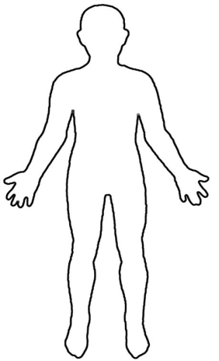
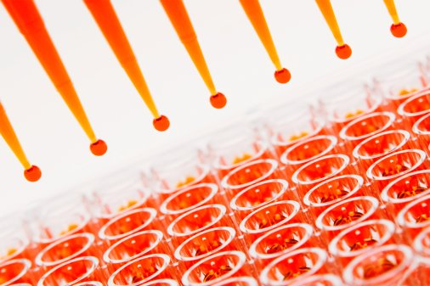


Quantitative in vitro to in vivo extrapolation (QIVIVE) A necessary tool to relate the nominal concentrations in in vitro assays to the equivalent in vivo human exposure
QIVIVE
EC₅₀ or other PoDs based on in vitro concentration-response curves
In vitro toxicity assays
Estimate of Human
Equivalent Dose
Notes:
3
Quantitative
Not just hazard-identification, but considering both exposure and response

Slide 4
Key elements of QIVIVE
QSAR
QSPR
Metabolite ID
In Vitro
Kinetics
Hepatic clearance
Intestinal uptake / metabolism
Renal clearance
Partitioning
Potential Target Tissue
Information on assay conditions
In vitro
Dynamics
Biokinetic Model
Prediction of chemical kinetics
Nature of Toxicity
PBPK modeling
Reverse Dosimetry
In Vivo Human
Safe Exposure Estimate
(modified from Yoon et al. 2012)

Slide 5
PBPK modeling is an effective tool for QIVIVE in an AOP framework
chemical
properties
molecular
target
cellular response
tissue
response
organism
response
Molecular Initiating Event
Identify key events
Toxicity pathway
Mode of action
Adverse outcome pathway

Slide 6
PBPK brings a tool to describe concentration-response relationship for early key event at the target in vivo for AOP-based safety assessment
PBPK models provide a physiological platform to incorporate in silico- and in vitro-derived chemical specific parameters to predict in vivo absorption, distribution, metabolism and excretion
IVIVE-PBPK modeling can be used in human safety assessment
to predict the in vivo exposure conditions that would produce chemical concentrations in the target tissue equivalent to the concentrations at which effects were observed with in vitro assays of tissue/organ toxicity
to support the identification of potentially susceptible populations associated with age-dependent pharmacokinetics or metabolic polymorphisms

Slide 7
Predicting kinetics in vitro - Critical research needs to move forward
In vitro based safety assessment
Cell-based assays
Renal excretion
QSAR for
classification
Consideration of free concentration
Accurate CL estimation
kinetics
Data/QSAR for partitioning
(expand region of prediction)
Intestinal
Absorption &
Metabolism
Hepatic Clearance
&
Metabolism
Distribution
Case studies
Metabolites ID
Extrahepatic Clearance
Case studies (esterases)
Parent/Metabolites dynamic profiles

Slide 8
IVIVE-PBPK Case Study I
MOS assessment using in vitro PoD and IVIVE-PBPK-predicted in vivo Css for parabens

Slide 9
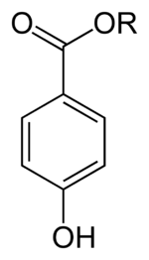
Parabens QIVIVE case study
Margin of Safety (MOS) assessment using IVIVE-PBPK models
PBPK-reverse dosimetry estimated plasma Css in general population (95%tile in NHANES)
Point of Departure in vitro (EC10 from in vitro estrogenic potential assay)
Human health concerns
potential for endocrine affects (weak estrogenic activity with ER receptor binding affinity ~ 100,000 fold < estrogen)
cumulative exposure to mixtures
in vitro PoD
MOS =
Plasma Css in general population

Slide 10
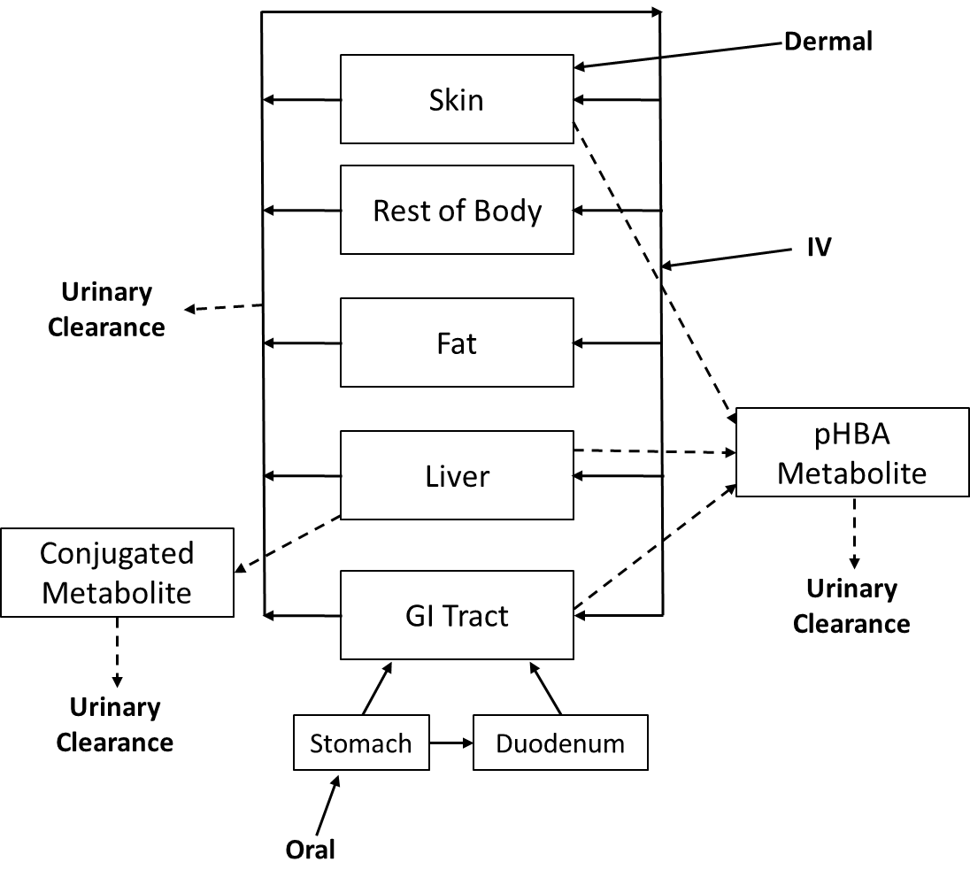
Human PBPK model for parabens
in vitro and in silico based parameterization
Hydrolysis
(mainly by microsomal CES)
Conjugation
(UGT and SULT)
* Biological scaling of in vitro-derived metabolic parameters (IVIVE)

Slide 11
Margin of Safety
Point of Departure
Two screens of estrogenic activity were included
ERLUX – reporter gene (luminescence)
E-SCREEN – mammary epithelial tumor cell (cell proliferation)
EC10 (µg/L) from assay
Cumulative toxicity was additive at the EC10 for the 17 compound mixture
Relative Potency Factor = EC10 of a paraben
EC10 butyl paraben

Slide 12
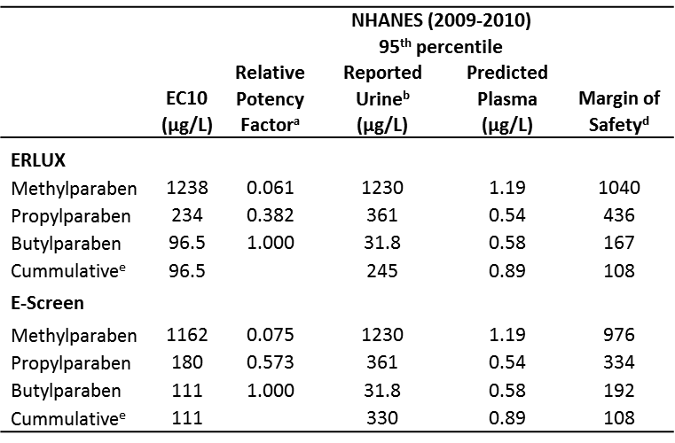
Margin of Safety
Adult Female

Slide 13
Paraben QIVIVE summary
Paraben PBPK model successfully developed using in vitro metabolism data and QSAR-predicted tissue partitioning
IVIVE-PBPK used for reverse dosimetry to estimate plasma Css based on NHANES urinary biomoritoring data
MOS calculated based on in vitro EC10 and general population exposure levels
Current limitations
Not enough data to describe full metabolic pathways - conjugation
Oral bioavailability partly informed from rat in vivo data – a new in vitro tool (human CES-2 expressed Caco-2 cells) is in development in-house

Slide 14
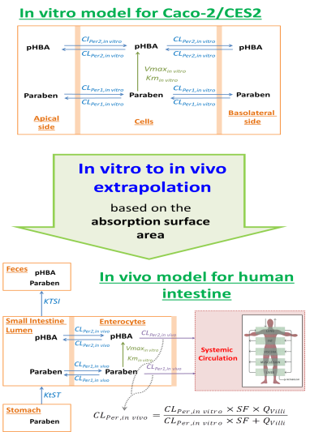
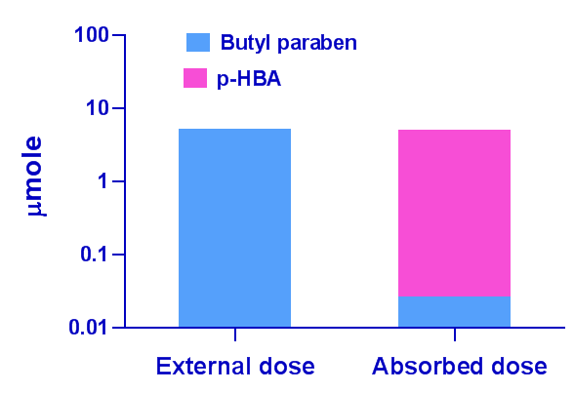
Predicting oral bioavailability in vitro for environmental esters (BuP case study)
Butyl paraben is preferentially metabolized by CES-2
Next step: incorporation of the gut description into the whole body PBPK model of parabens

Slide 15
IVIVE-PBPK Case Study II
Predicting early life target tissue dosimetry for pyrethroids to identify potentially sensitive populations

Slide 16
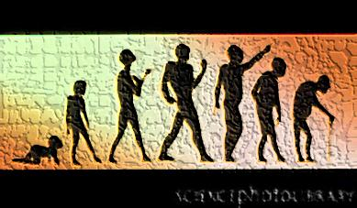
Integrating key determinants of early life dosimetry with IVIVE-PBPK
Life stage PBPK MODEL
Age-specific internal dose
Age-dependent physiological changes
Age-dependent biochemical changes
Age-appropriate exposure
(CARES or SHEDS)
Requires in vitro data-based parameterization

Slide 17
Major challenges in IVIVE for human early ages for environmental chemicals
Human in vivo data is necessarily limited (in contrast to pharmaceuticals), leading to a reliance on in vitro data. However:
Pediatric tissues samples are very difficult to obtain and sample quality is generally uncertain
Addressing human variability is challenging
IVIVE with recombinant enzymes in conjunction with enzyme ontogeny of expression is selected as an alternative approach

Slide 18
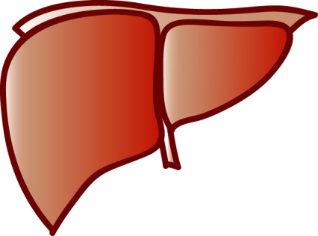
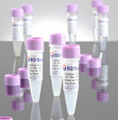
In vitro metabolism studies for pyrethroid IVIVE
Rat
Human
Subcellular fractions
Age-specific liver donors
Recombinant enzymes
Cytosol
CESs
Human recombinant enzymes
Microsomes
Individual CYP or CES enzymes
CYPs + CESs
Notes:
The catalytic activity of cytochrome P450 enzymes requires interaction with it redox partner, NADPH:cytochrome P450 oxidoreductase (OR). Another hemoprotein, cytochrome b5, can stimulate the catalytic activity of some cytochromes P450 for some substrates.

Slide 19
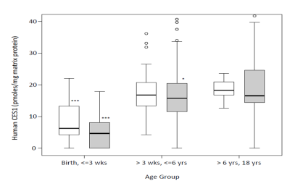
Developing an early age human PBPK model for deltamethrin
QBR
Brain
QBR
Adult liver metabolism by CES1
QF
Fat
QF
Age-appropriate metabolism
parameters from in vitro data
QS
Slowly
QS
Plasma
QR
Rapidly
QR
CES1 ontogeny
IVIVE
QH
QL
Liver
QGI
QGI
GI tissue
Metabolism
(CES and CYP)
Human Growth Physiology
Lymphatic absorption
Lumen
Oral dose
Fecal excretion
Human relevant Exposure

Slide 20
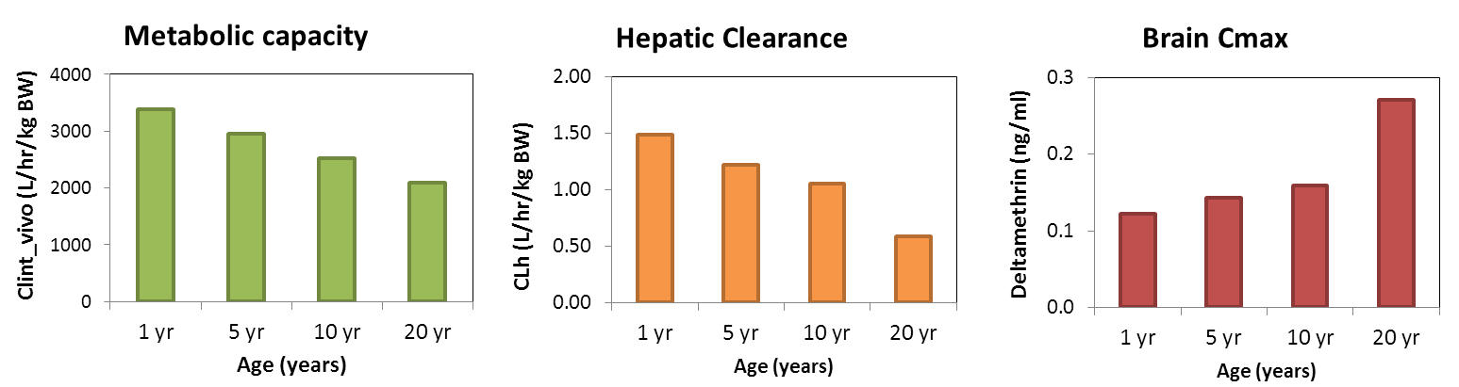
Building human age-specific deltamethrin models based on IVIVE
Measuring metabolic rates (CES-1)
Clint_microsomes = 24 ml/min/mg
Clint_cytosol = 6 ml/min/mg
(LFR, preliminary)
Integration in PBPK models
Enzyme ontogeny
(CES-1)
Mature within 6 months after birth
(Hines et al., submitted)
Ontogeny on Liver weight and blood flow (Clewell et al., 2004)
Ontogeny on the scaling factor (MPPGL) (Barter et al., 2007;2008)
IVIVE
All ages
Average adult in vivo
Clint = 86896 L/hr/kg liver
in adults
(mainly CES-1 mediated)
Age-specific metabolic capacity
Clint_in vivo

Slide 21
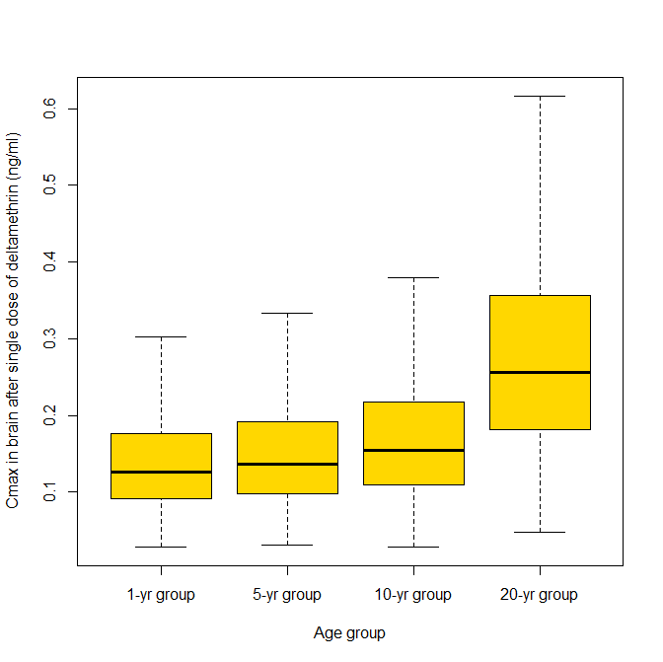
IVIVE-PBPK predicted target tissue exposure in early ages
Brain Cmax (ng/ml)
1yr
5 yr
10 yr
Adult
Age
Single dose of deltamethrin 0.005 mg/kg was used for Monte Carlo simulation
Notes:
5,000 individuals simulated for each age group using Monte Carlo simulation

Slide 22
Future directions in QIVIVE
Improving in vitro assays to accurately predict
Bioavailability with pre-systemic clearance
Hepatic clearance and in vivo metabolism profiles
Major drawback in current QIVIVE is lack of consideration for metabolite-mediated toxicity
Building database for human metabolism covering a wide range of chemical spaces using in vitro data
To develop predictive in silico tools for human metabolism and metabolites and their potential bioactivity

Slide 23
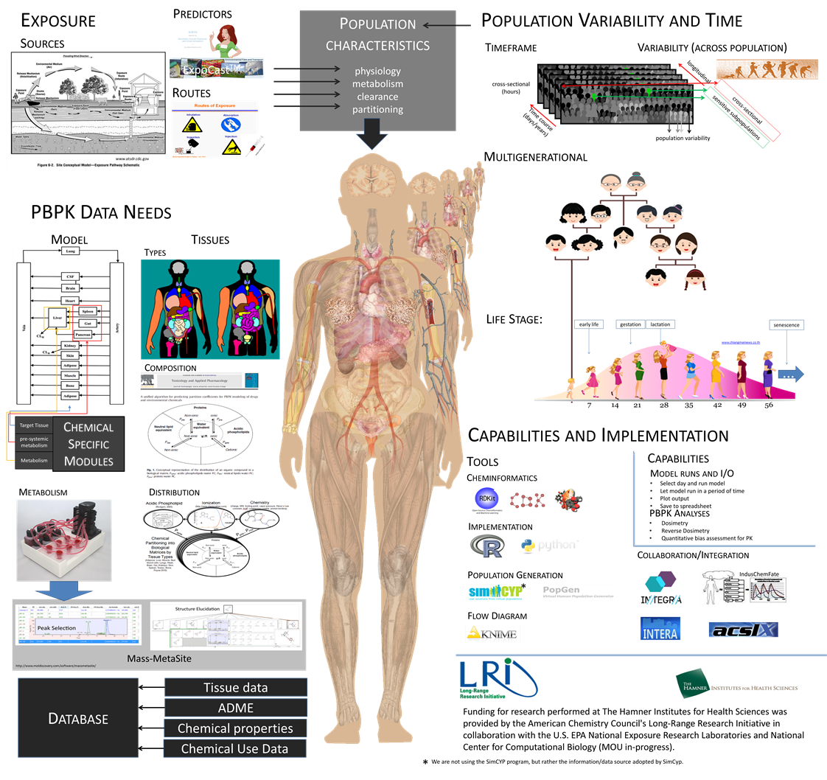
Towards a generic predictive modeling platform for QIVIVE for human safety assessment
Population Lifecourse Exposure to Health-Effect Modeling Suite
(PLETHEM)

Slide 24
Acknowledgements
QIVIVE, Paraben case study, and PLETHEM project
Jerry Campbell (Hamner)
Cory Strope (Hamner)
Harvey Clewell (Hamner)
Funded by ACC-LRI
Pyrethroids IVIVE
Huali Wu (Hamner)
Harvey Clewell (Hamner)
Brian G. Lake Lab (LFR)
James Bruckner Lab (UGa)
Gail McCarver/Ron Hines Lab (Medical College of Wisconsin)
Thomas Osimitz (Science Strategies, LLC)
Funded by the Council for Advancement of Pyrethroid Human Risk Assessment (CAPHRA)

